Slide 1
Developing a Traceability Tool for Safety Critical Systems
Supervisor: Nasser Mustafa
Haotian Xue Yujia Huang Chen Xu Li Tianyi
Guo Ziyi Xu Chenyi Wang Xuhang Fu Leyong
Liu Yukun

Slide 2
Traceability Framework for Safety Critical Systems
Traceability UML Model: a Class diagram that represents a collection of classes mainly, the trace links, artifacts, and user Information
Traceability Database: Stores the information obtained from the Traceability Model
Trace Links Taxonomy: categorizes the trace links obtained from various domains
Traceability Management System (TMS): based on the UML model and Interacts with the Database
Graphic Visualization : Controlled by the TMS, It shows the traceability information in a graphical view
Reporting System: Controlled by the TMS. It produces different types of reports

Slide 3
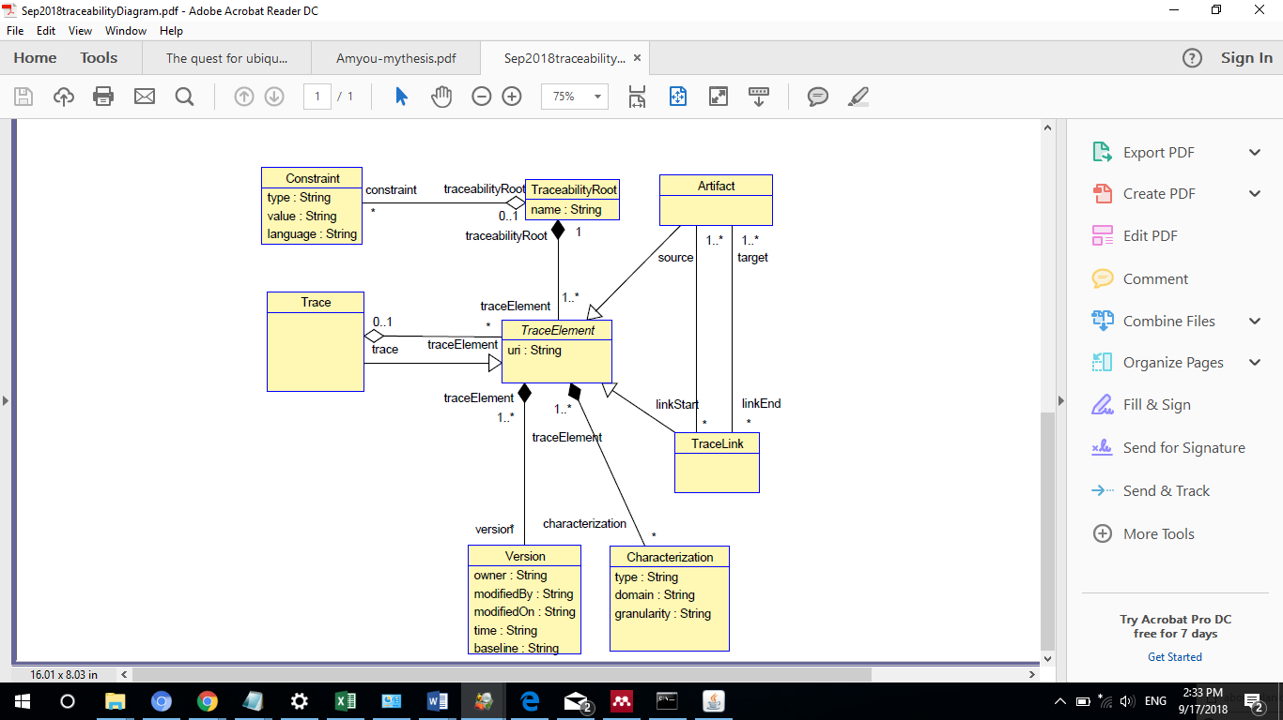
UML Traceability Model

Slide 4
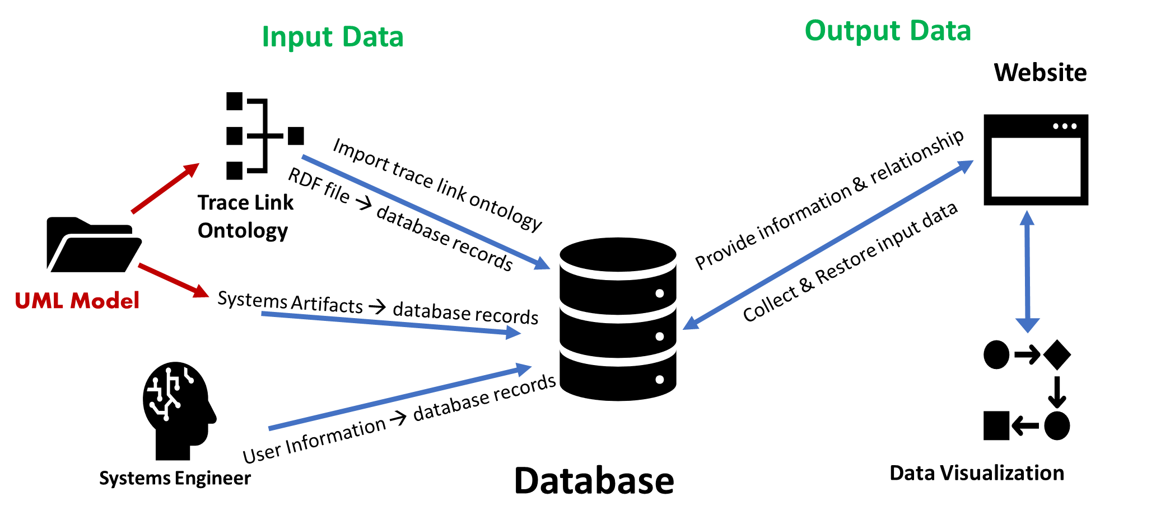
Components Interaction

Slide 5
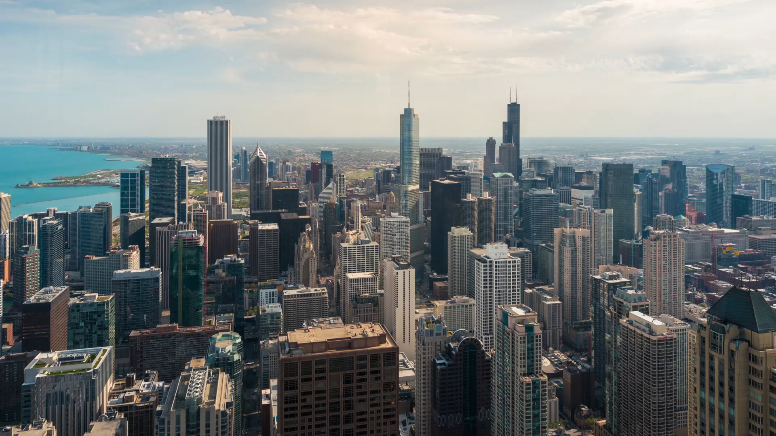
Database Design

Slide 6
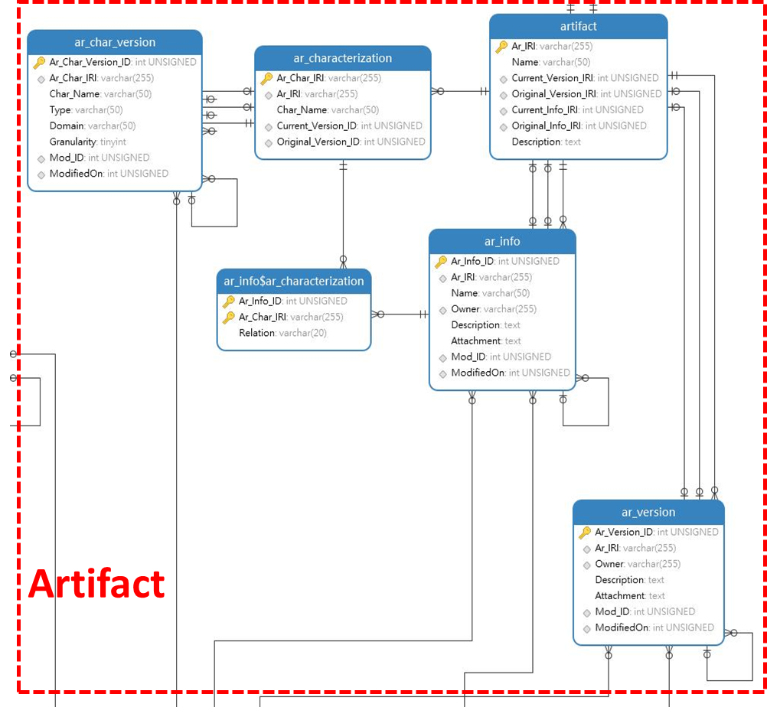
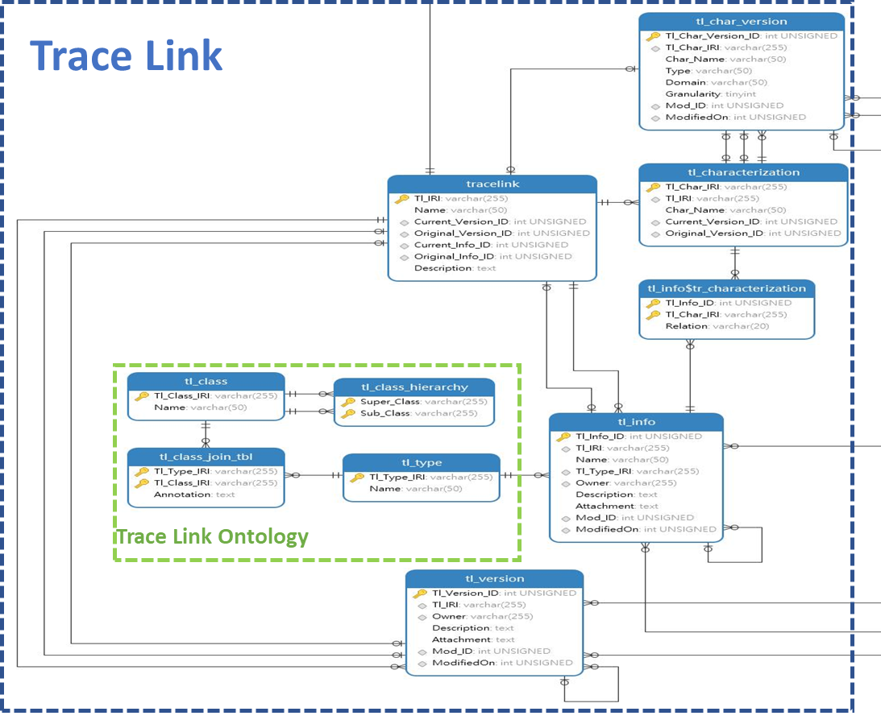

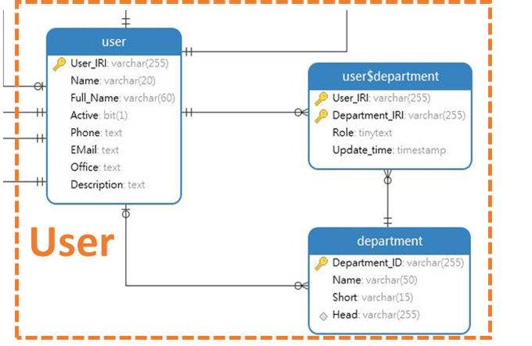
Database Design
Artifacts
Trace Links
User Information

Slide 7

Trace Links

Slide 8
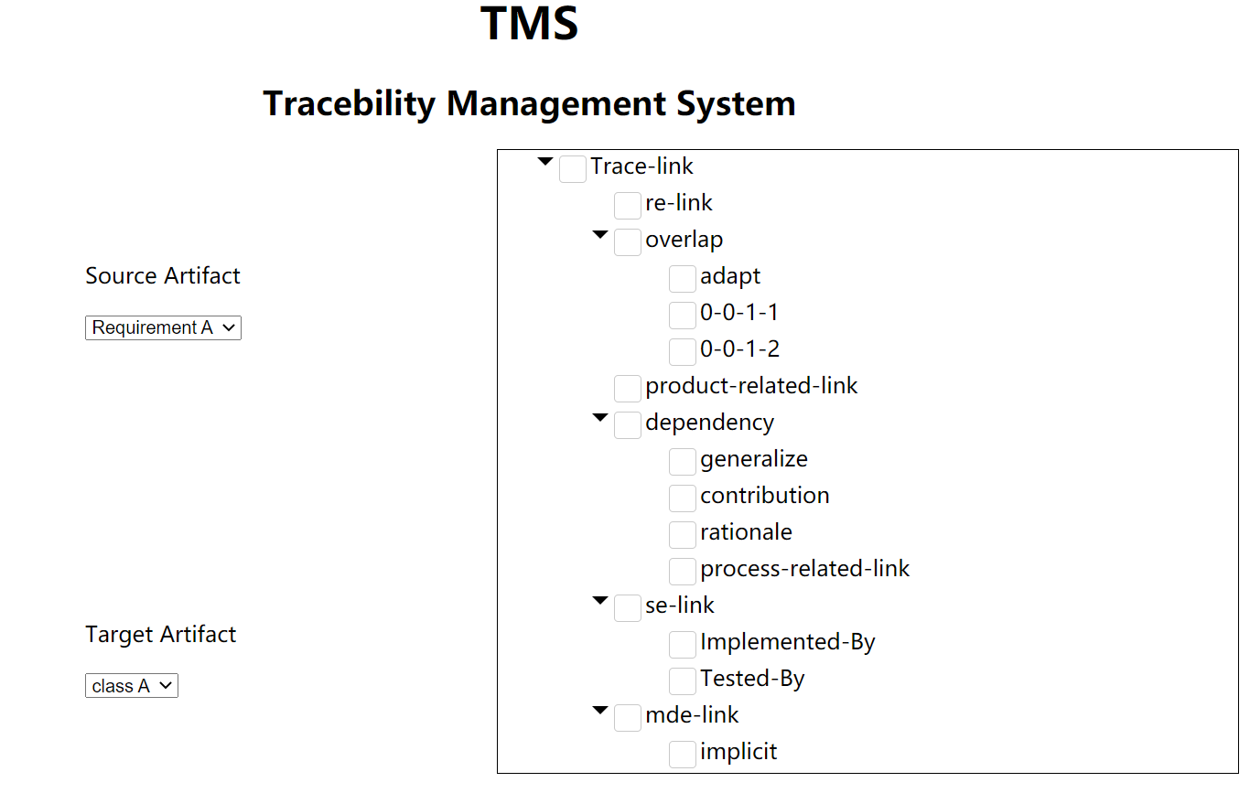

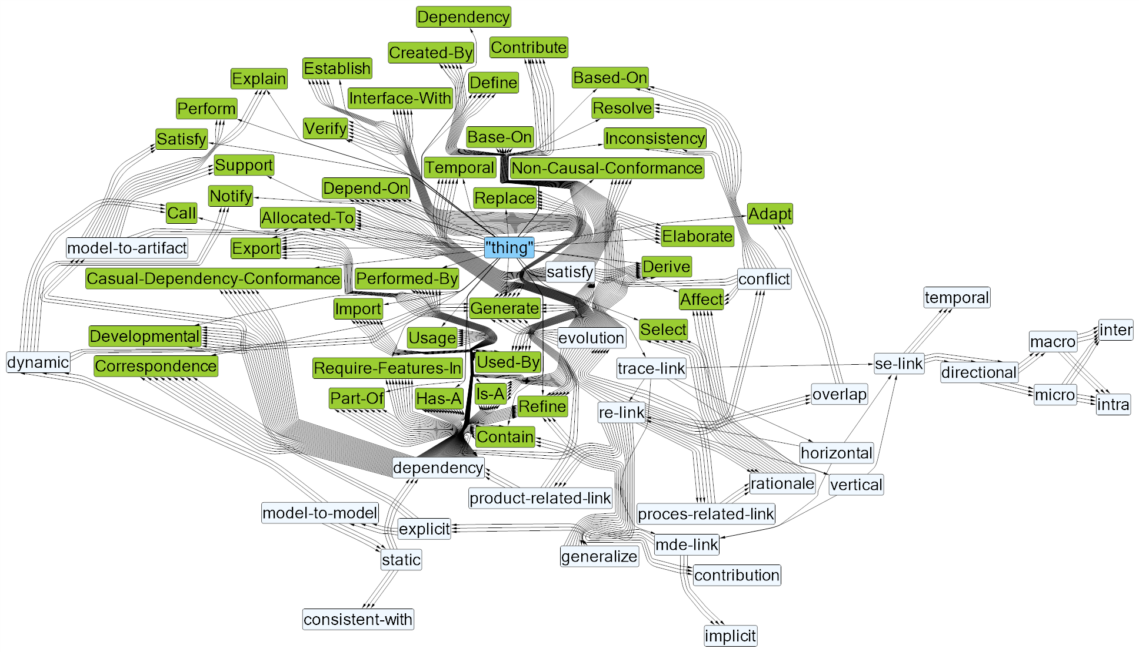
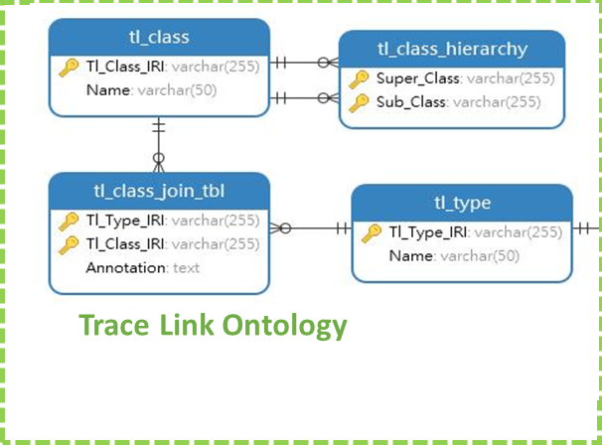
Trace Links Taxonomy
TMS
Trace Links Script file
1
Implements
3
Retrieve
2
Reads and Store
Database
Trace Links diagram

Slide 9
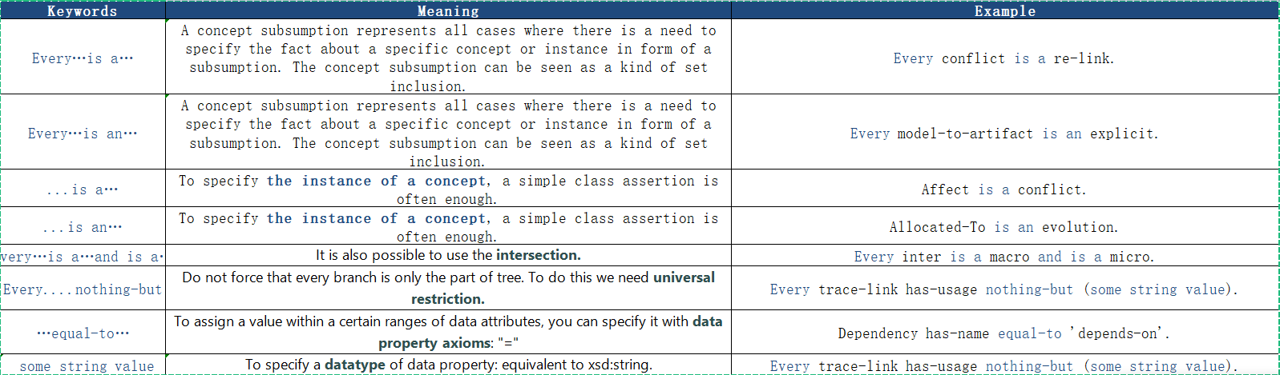

Slide 10
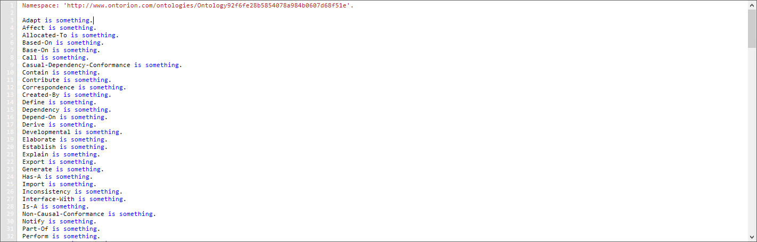
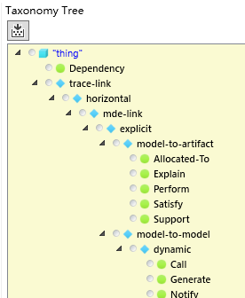

Slide 11
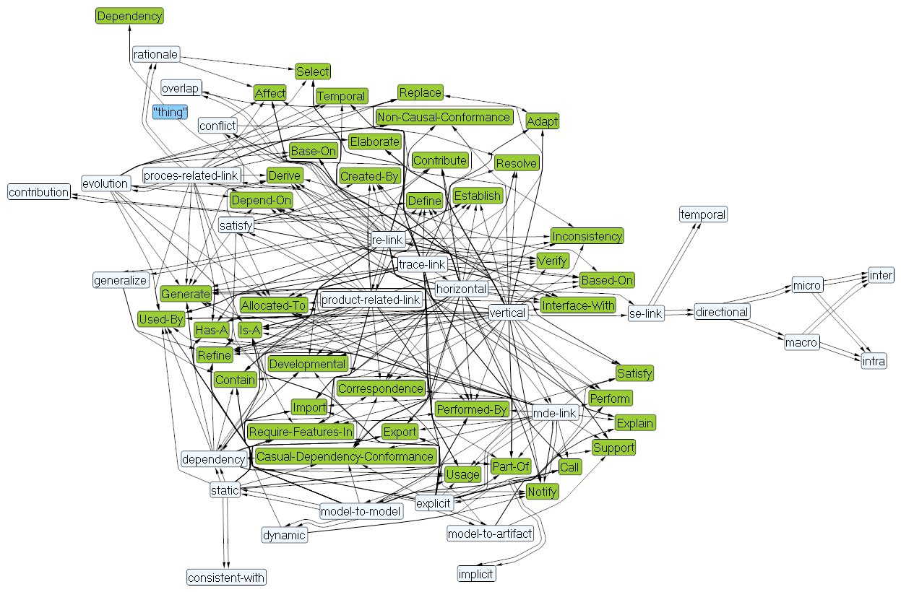
Trace Links Taxonomy Graph

Slide 12
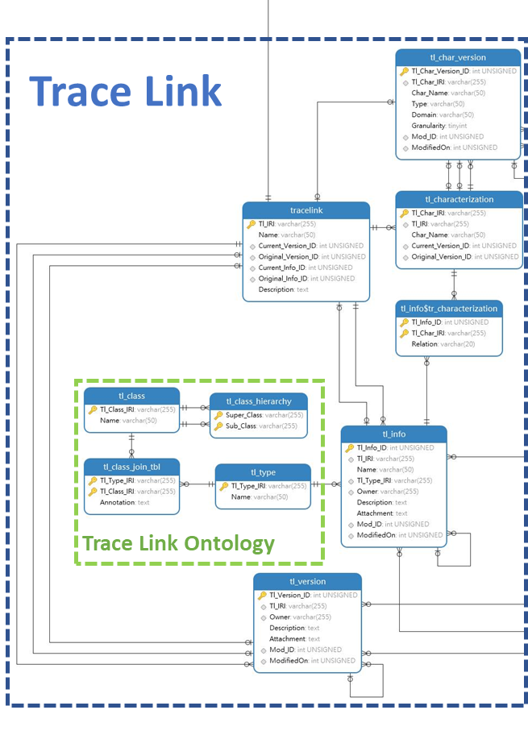
Partial Database for Trace link tables

Slide 13

TMS Design
and Implementation

Slide 14
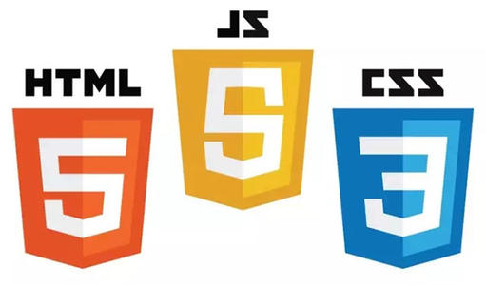
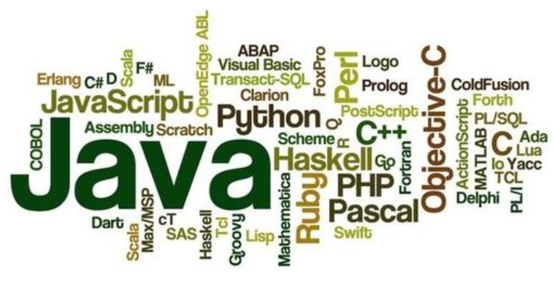
TMS Design and Implementation
Front-end
Back-end

Slide 15
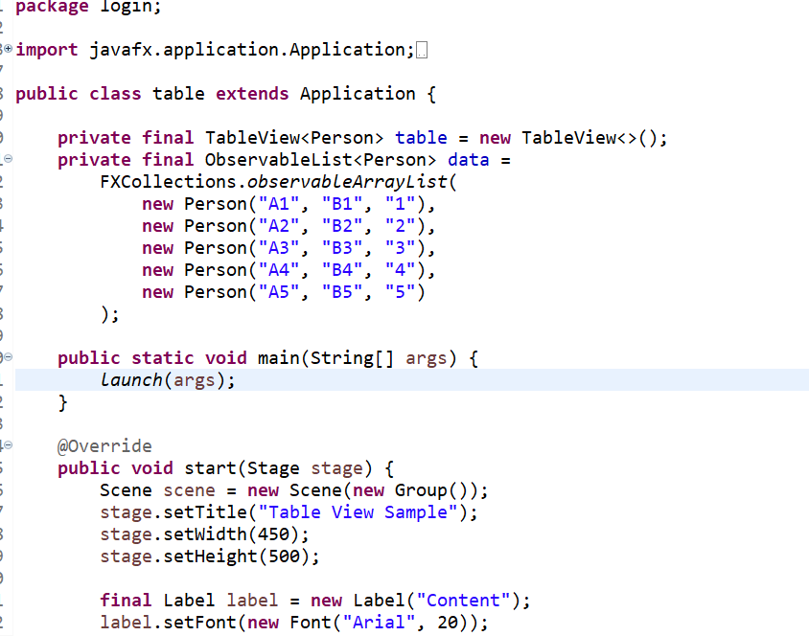
Connect to Database
We use JavaFX to finish these part to do the visualization of database and show it to users

Slide 16
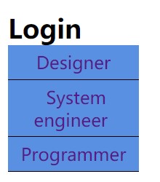
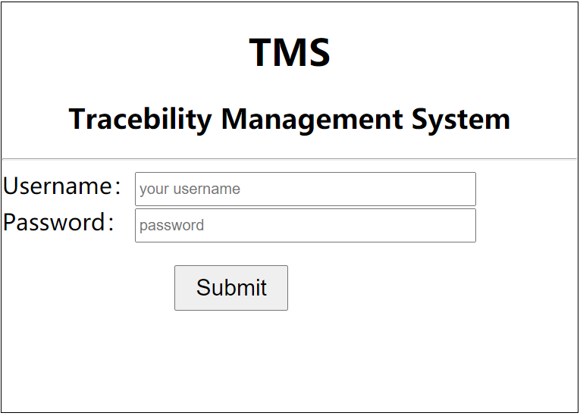
Login
Different authority for each kind of users

Slide 17
Record Traceability Information

Slide 18
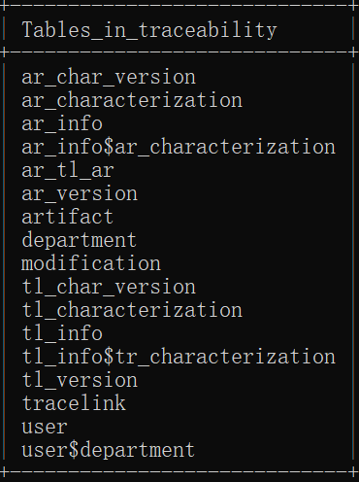
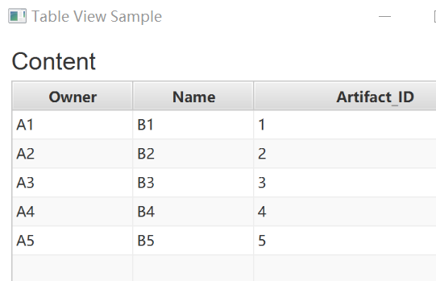
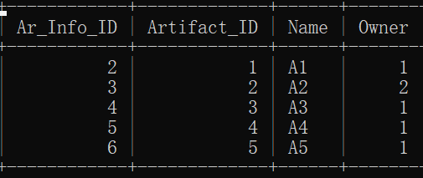
Recording Traceability Information

Slide 19
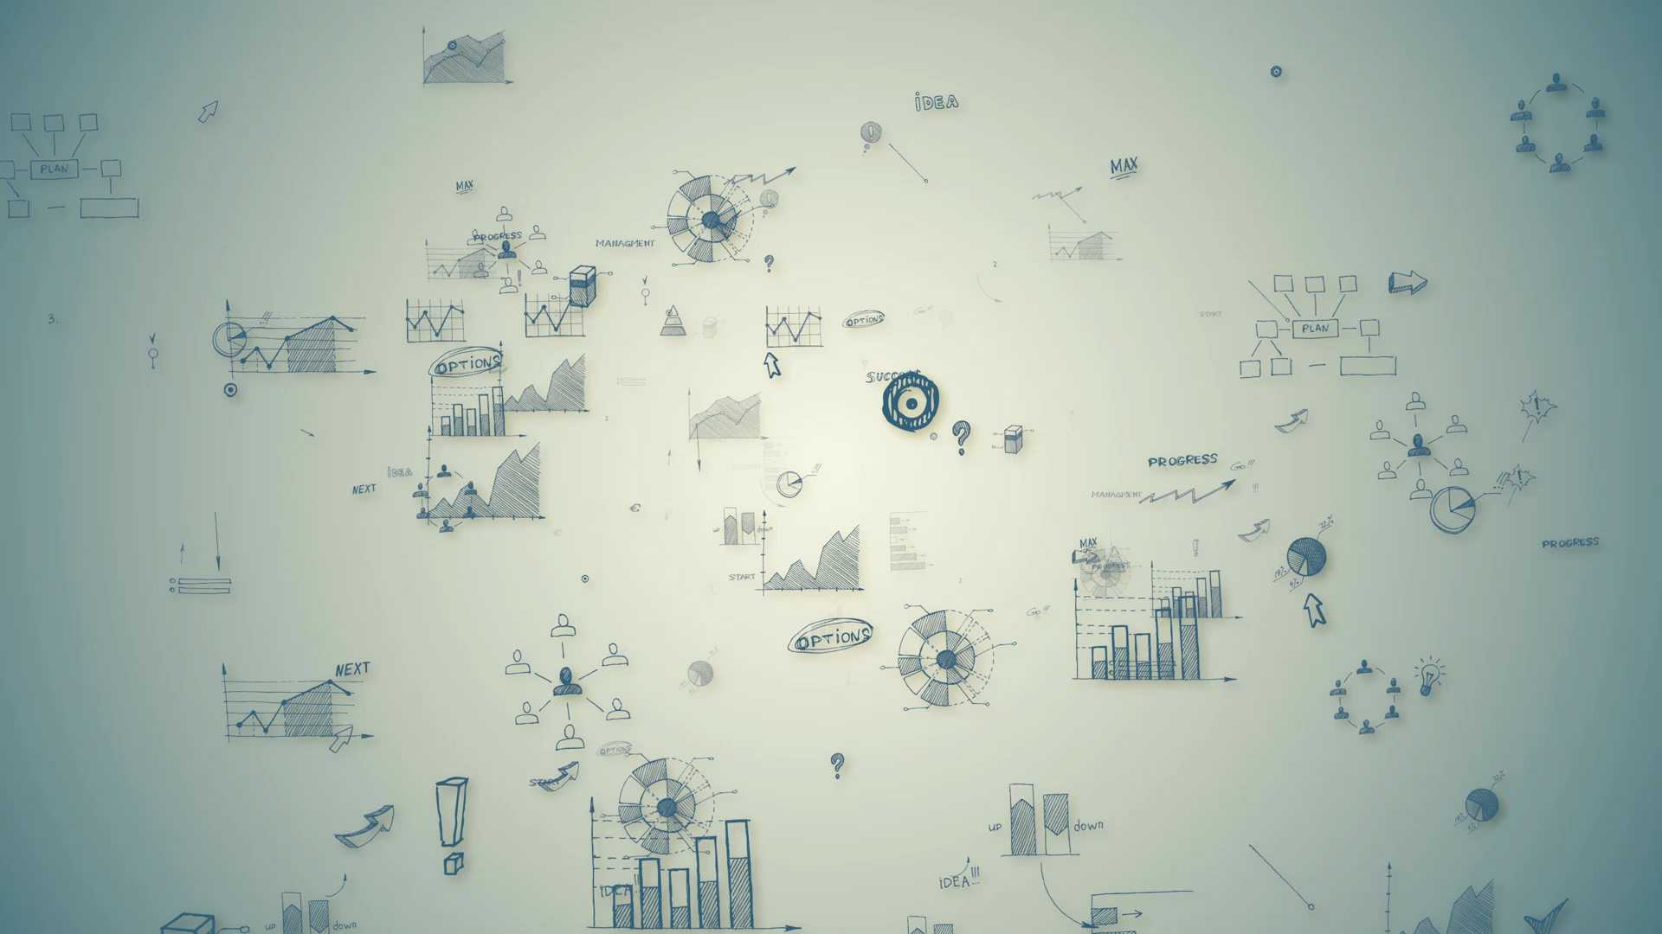
Visualizing Traceability Information

Slide 20
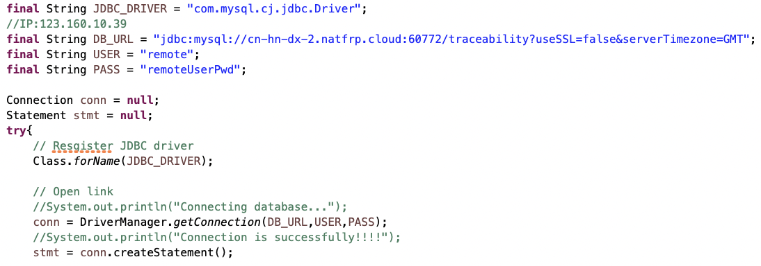
Database connection (JDBC Driver)

Slide 21
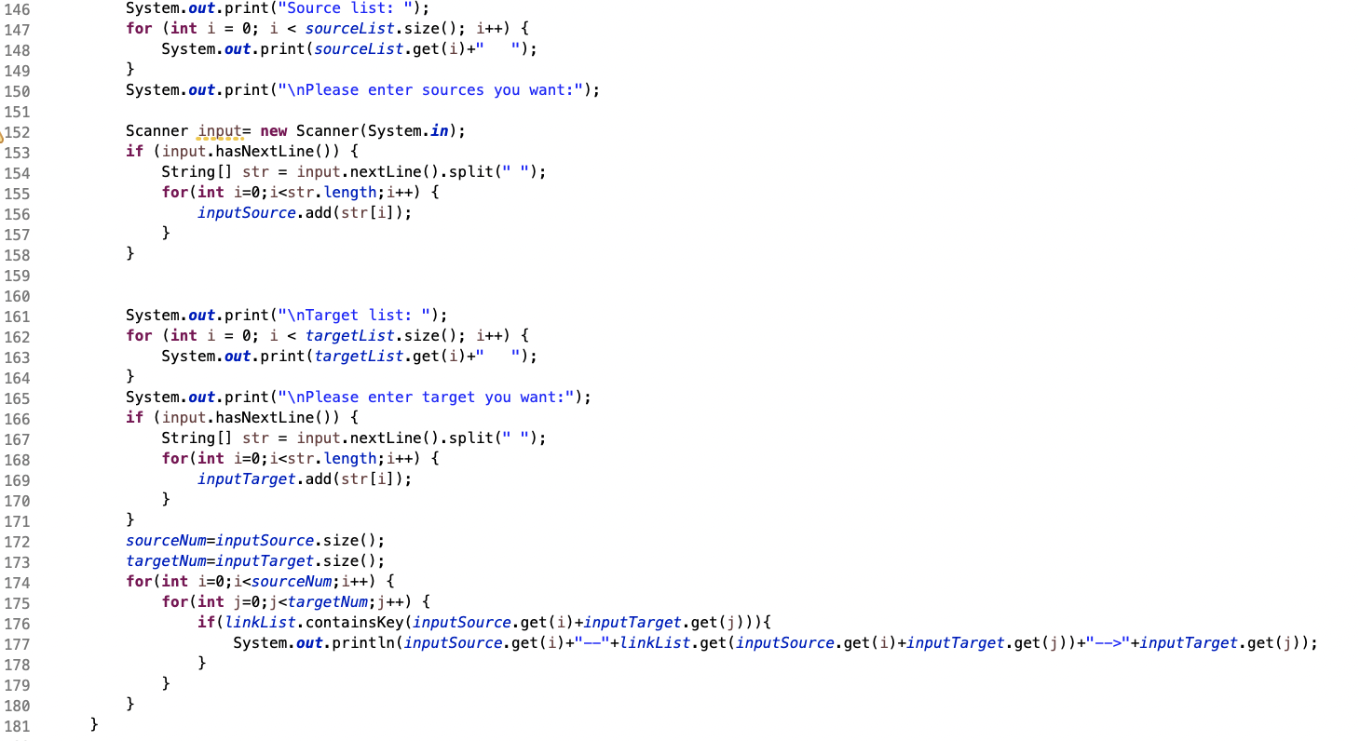
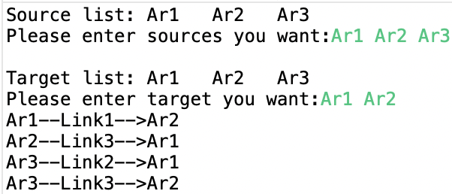
Implement user interaction

Slide 22
DB Features
Trace Link
Source Artifact
Target Artifact

Slide 23
DB Features
Trace Link
Source Artifact
Name
IRI
Type
Modification time
Owner
Characterization
..
Target Artifact
Name
IRI
Modification time
Owner
Characterization
..
Name
IRI
Modification time
Owner
Characterization
..

Slide 24
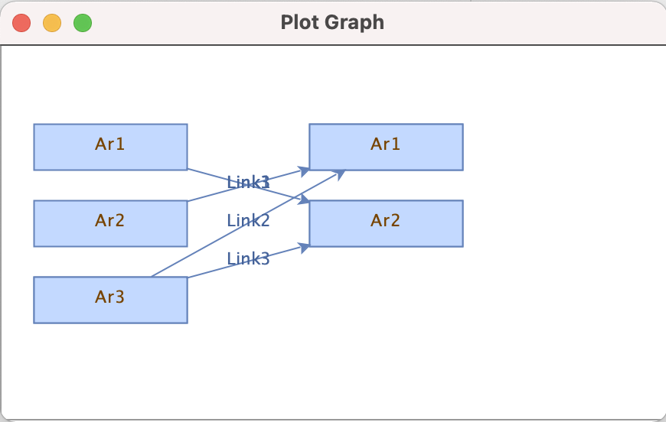
R Graph Visualization(Swing & JGraph)

Slide 25
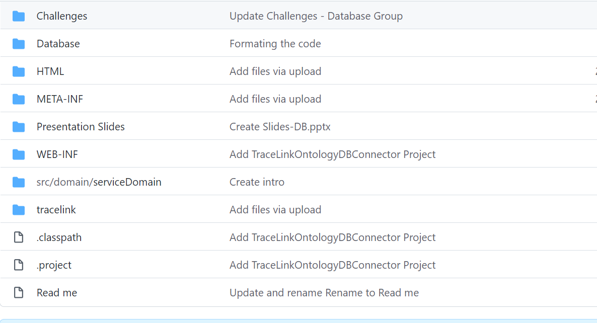
GitHub Part

Slide 26
Conclusion and Lesson Learned
Learned new technical skills related to programming languages and software application
Learned how to work in groups
Learned how to build complex systems and integrate components
Simulating the industrial environment in terms of gluing many components and collaborating with other teams
Learned research skills and how to face challenges
Presentation skills

Slide 27

Thank you

